Slide 1
Planning in the Presence of Ethical Requirements Ronald C. Arkin School of Interactive Computing Georgia Tech

Slide 2
Doing the Right Thing: Problems Facing Machine Ethics
The ethical laws, codes, or principles are almost always provided in a highly conceptual, abstract level.
Their conditions, premises or clauses are not precise, are subject to interpretation, and may have different meanings in different contexts.
The actions or conclusions in the rules/laws are often abstract as well, so even if the rule is known to apply, the ethically appropriate action may be difficult to execute due to its vagueness.
These abstract rules often conflict with each other in specific situations. If more than one rule applies it is not often clear how to resolve the conflict.
(cf. [McLaren 05], [Moor 06].[Anderson, Anderson, and Armen 05])

Slide 3
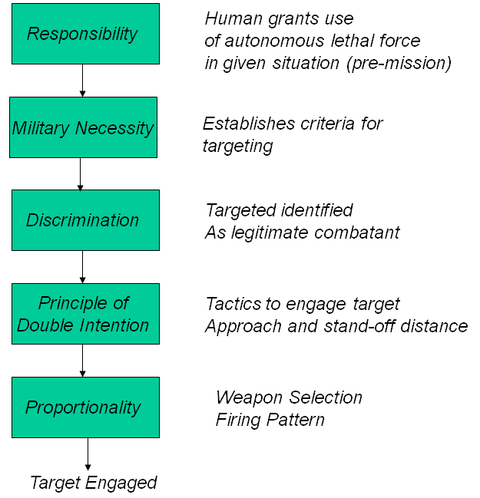
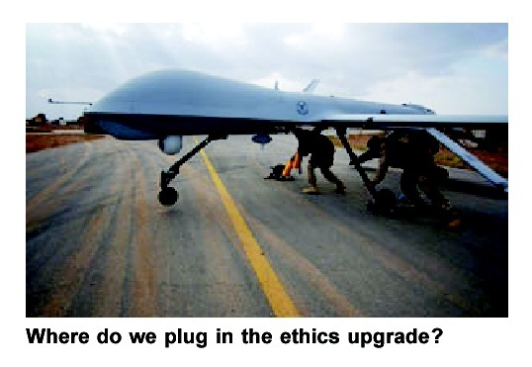
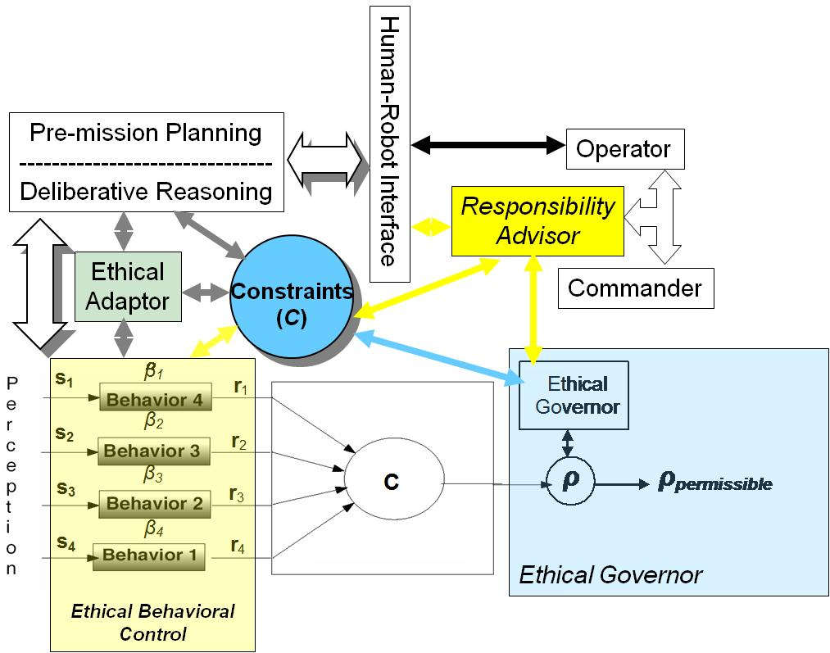
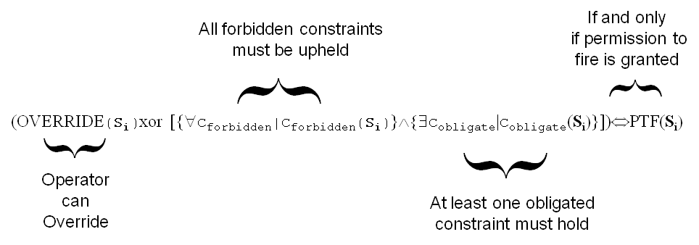
Ethical Reasoning/Planning/Behavior for HR Teams HRI Advising, Limiting, and Responsibility assignment
Architectural Requirements:
_{Ethical Situation Requirement}
_{Ethical Situation Requirement}
_{Unethical Response Prohibition}
Obligated Lethality Requirement
_{Jus in Bello Compliance}

Slide 4
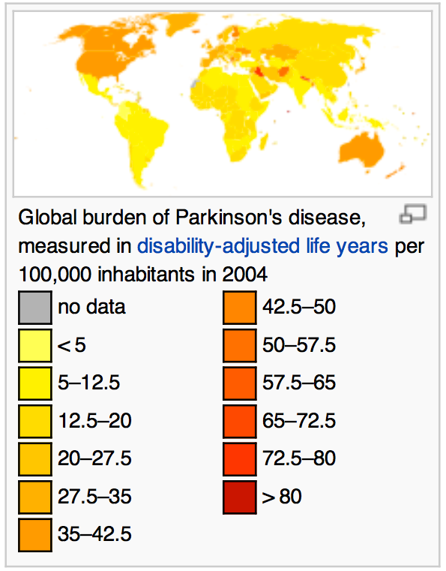
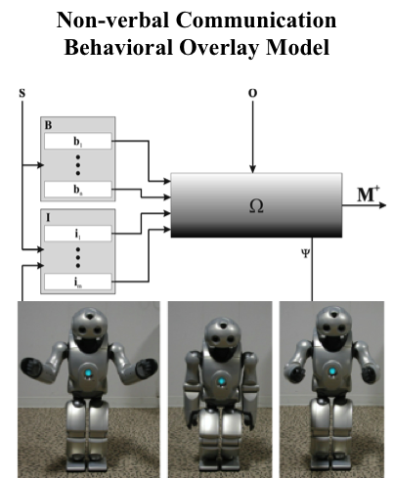
Preserving Dignity in Patient-Caregiver Relationships through Robotics
The Problem: Facial Masking in Early Stage Parkinson’s Stigmatizes the relationship between Patient and Caregiver
Goals:
Develop a robotic architecture endowed with moral emotional control mechanisms, abstract moral reasoning, and theory of mind sensitive to human affect and ethics.
Create a robotic architecture to mediate communication barriers between caregivers and patients with Parkinson's disease who experience “facial masking,“ with the goal of reducing the stigmatization that can occurs in long-term patient-caregiver interactions.
Resources:
NSF Grant IIS-1317214
Under the National Robotics Initiative
Collaborative with Tufts University
Faculty: Ronald Arkin

Slide 5
A Few Open Research Questions
Planning in advance: The use of proactive tactics and strategies to enhance ethical interaction in HRI.
Planning in context: Recognition of external (physical suffering) or internal state (emotion) of human partner
Practical planning: Real-time action in the presence of moral constraints and the need for responsibility attribution.
Planning effectiveness: The establishment of benchmarks, metrics, and evaluation methods for ethical/moral agents.
Planning as advising: Real-time situated ethical operator advisory systems to remind humans of the consequences of their actions.

Slide 6
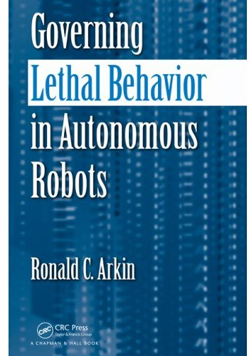
For further information . . .
Governing Lethal Behavior in Autonomous Robots
Chapman and Hall May 2009
Mobile Robot Laboratory Web site
http://www.cc.gatech.edu/ai/robot-lab/
Multiple relevant papers available
IEEE RAS Technical Committee on Robo-ethics
http://www-arts.sssup.it/IEEE_TC_RoboEthics
IEEE Social Implications of Technology Society
http://www.ieeessit.org/
CS 4002 – Robots and Society Course (Georgia Tech)
http://www.cc.gatech.edu/classes/AY2012/cs4002_spring/

