Slide 1
Challenges in Multi-Robot
Path Planning
Pete Wurman
CTO

Slide 2
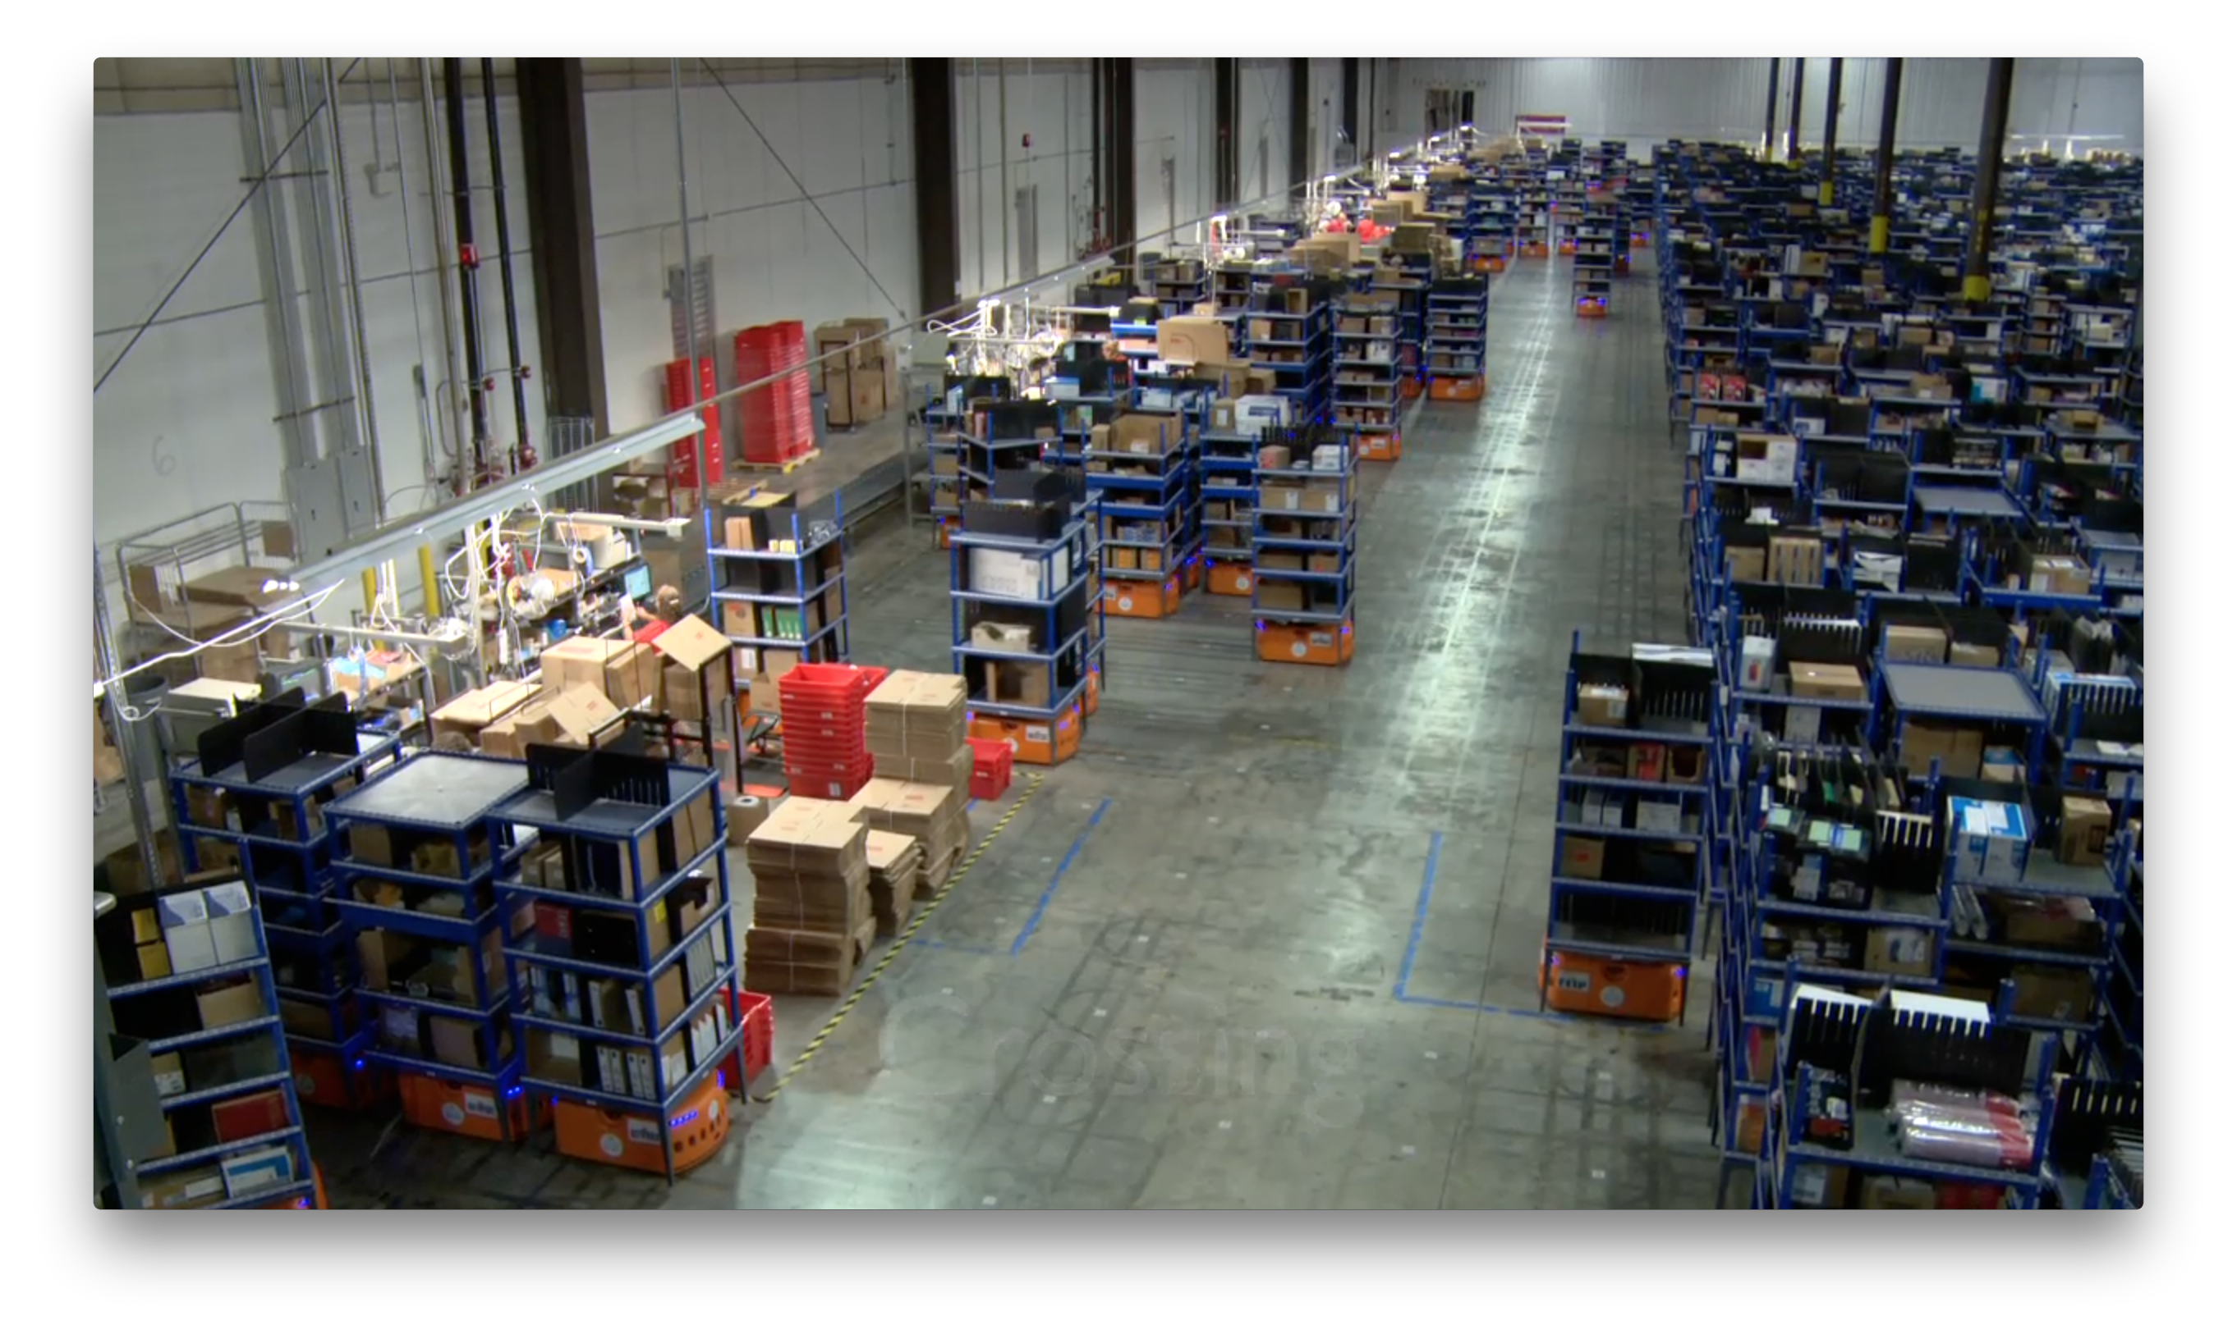

Slide 3
What is the Path Planning Challenge
> 1,000 robots
  Moving ~ 1m/s
  Discrete grid
  As dense as 1 robot for every 6 cells
Online
  5 min missions ➔ 3 new tasks per second
Fan-in, Fan-out Patterns
  Robots carry pods to stations on perimeter
  Return them to (different) empty spots in storage
Humans In the Loop
  Imperfectly predictable human tasks at stations
  Leads to imperfectly predictable release of pods
  Release 1 pod every 6-12 seconds

Slide 4
Challenge Problem

Slide 5
Challenge Problem

Slide 6
Coordinated Path Planning
How should the future paths of other robots play into the planning of a new path?
  When they are converging on the same spots
  When their performance varies
  When the human is part of the plan
  When new activities are starting frequently

