Slide 1
Planning in the robotics toolbox
Kris Hauser
School of Informatics and Computing
Indiana University
NSF Workshop on Robot Planning in the Real World

Slide 2
A decade of Planning Breakthroughs

Slide 3
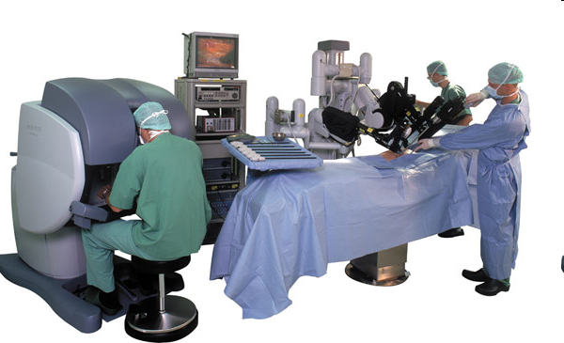
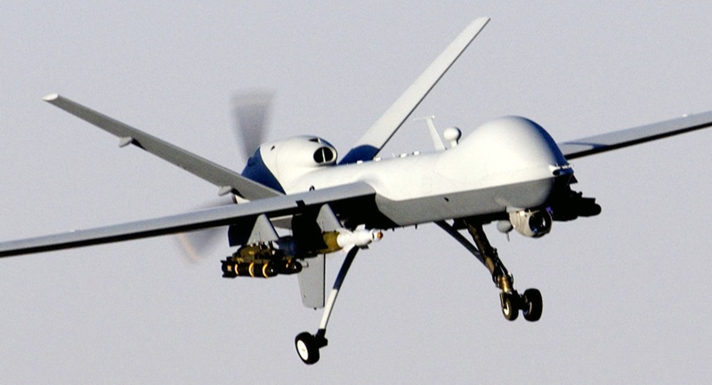
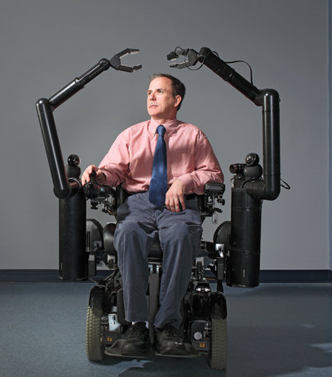
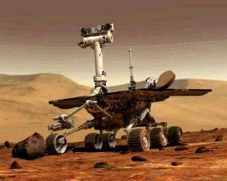
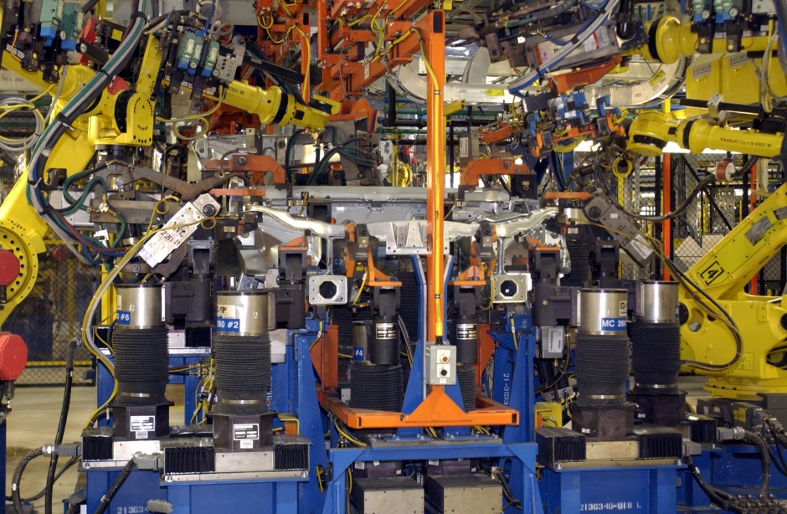
A decade of Planning Breakthroughs
Can you spot the planner?

Slide 4
?
Actions
Goals
Planning
Research directions
Goals
This workshop

Slide 5
?
Actions
Goals
Planning
A planner on every robot
Research directions
This workshop

Slide 6
DARPA Robotics Challenge
Recent experiences…
Semiautonomous robots

Slide 7
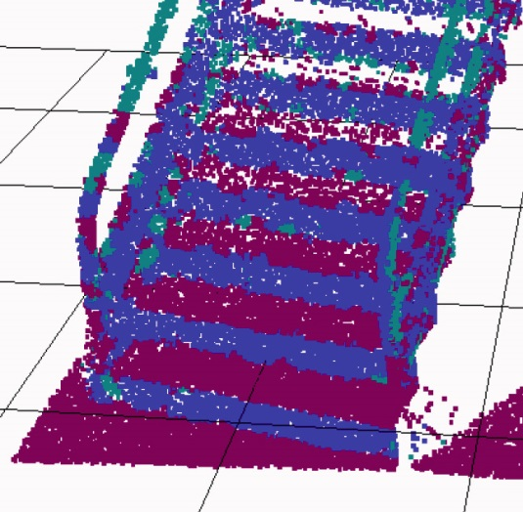
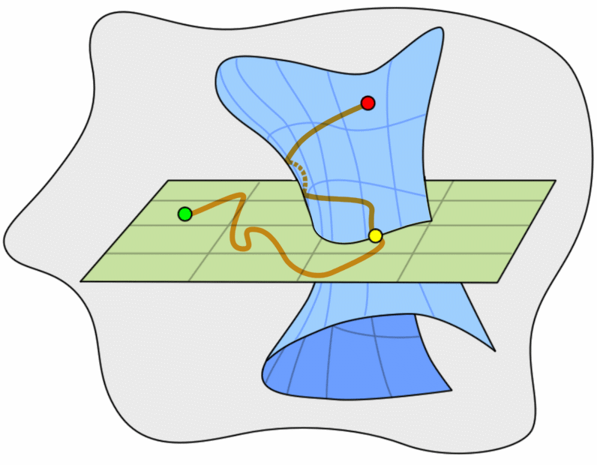
Challenges
Planners are not easy to integrate in real robots
Dynamic models are nonlinear, uncertain, multi-modal; constraints are uncertain; objective functions are complex
High variability in performance, hard to debug
Lots of algorithms, few benchmarks
You shouldn’t need a PhD to integrate a planner
Time t
Time t+1
$$it$$
$it$₊₁
σ₂
C
Transition
$$zt$$
$zt$₊₁
$$ht$$
$ht$₊₁
σ₁
$$ot$$

Slide 8
challenges
Planners are not easy to integrate in real robots
Dynamic models are nonlinear, uncertain, multi-modal; constraints are uncertain; objective functions are complex
High variability in performance, hard to debug
Lots of algorithms, few benchmarks
You shouldn’t need a PhD to integrate a planner
Planners are still too slow to deliver high-quality motions in interactive time or real time
State-of-the-art perception models : non-negligible time
High performance computing, cloud, GPUs
Dramatically new paradigms?

Slide 9
Thank you!

